Slide 1

School of Computer Science and Engineering
Department of Computer Science and Engineering
Deep Learning for Synthetic Media Detection
Submitted By:Arindam Sharma
2427030837
Supervised By:Mahesh Jangid Sir

Slide 2







Presentation Outline
Introduction
Problem Statement
Objectives
Motivation & Scope
Literature Survey
Proposed System
Dataset

Slide 3
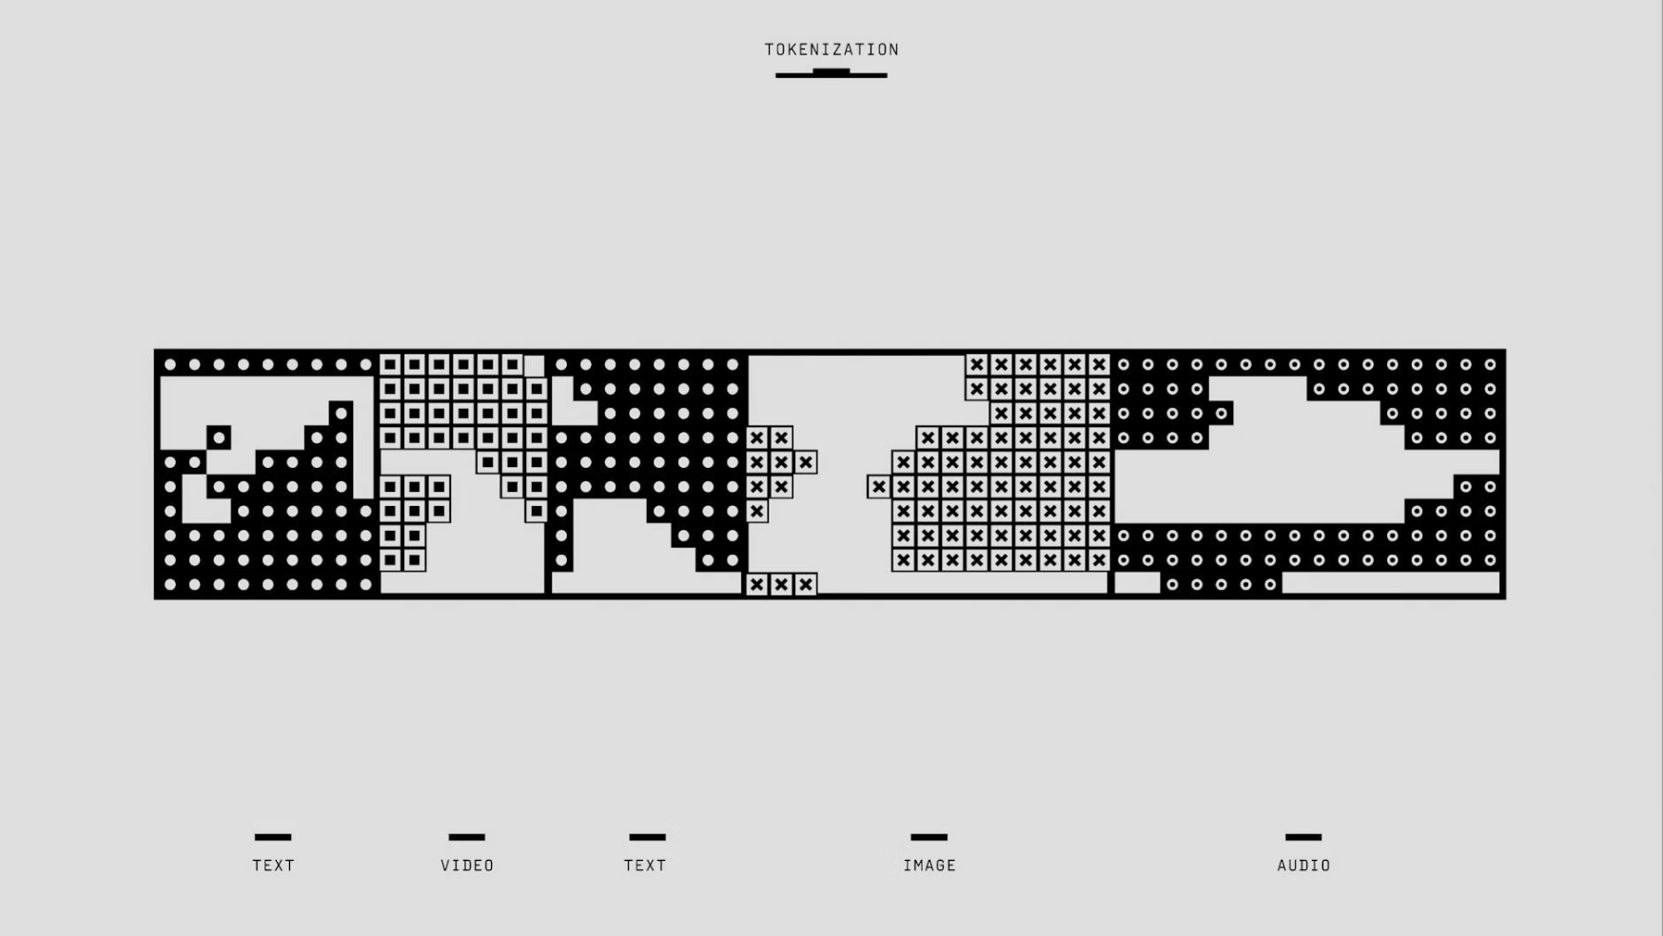
The Rise of Synthetic Media
The rapid growth of AI and Deep Learning has enabled the creation of highly realistic synthetic media — images, audio, and videos generated by machines. Deepfakes leverage sophisticated neural networks, such as Generative Adversarial Networks (GANs) and Autoencoders, to produce content that is virtually indistinguishable from authentic media.
Beneficial Applications
Entertainment & Film Industry (e.g., Paul Walker in Fast and Furious)
Education & Training (e.g., MIT Media, Holocaust Museum in Israel)
Accessibility (e.g., Speech Impairment solutions)
Gaming (e.g., AI Avatars)
Art & Creativity
Despite these advantages, Deepfakes pose significant ethical, legal, and social risks.

Slide 4

The Dark Side of Deepfakes
The exponential advancement of AI and deep learning has empowered the creation of highly realistic synthetic media, commonly known as deepfakes. While the technology has positive applications, its misuse is escalating.
Political Manipulation
Used to create deceptive content that can sway public opinion and undermine democratic processes.
Financial Fraud & Identity Theft
Exploited to impersonate individuals for fraudulent financial gains and identity compromise.
Non-Consensual Content
Fabrication of explicit or defamatory content without consent, leading to severe personal and reputational damage.
The sophistication of deepfakes renders traditional detection methods insufficient, making it increasingly difficult for individuals and systems to distinguish authentic media from fabricated content.

Slide 5
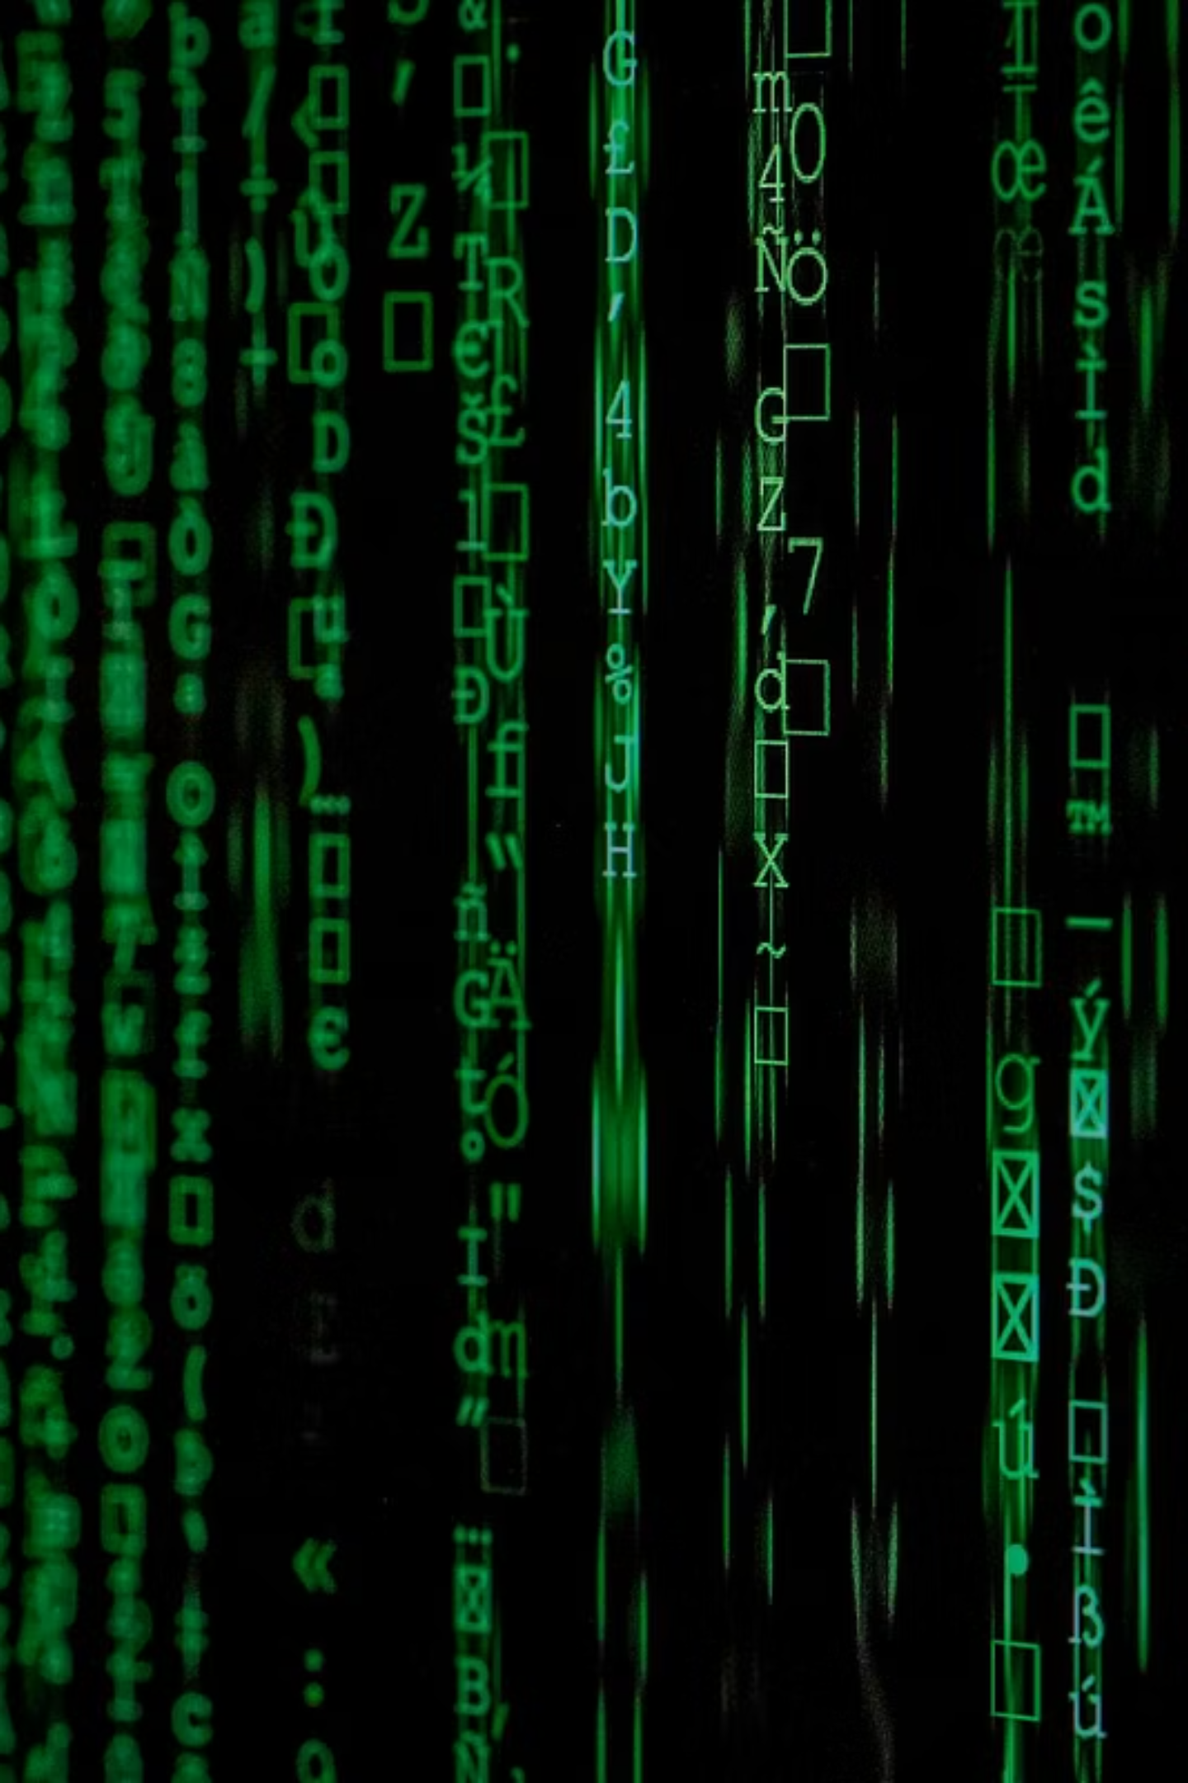
Problem Statement
"To design and implement a deep learning-based system capable of analyzing digital images and classifying them as either real or synthetically generated media."
This project addresses the critical need for robust tools to combat the proliferation of malicious synthetic media. By developing an effective detection system, we aim to contribute to digital trust and media integrity in an age where visual evidence can be easily manipulated.

Slide 6
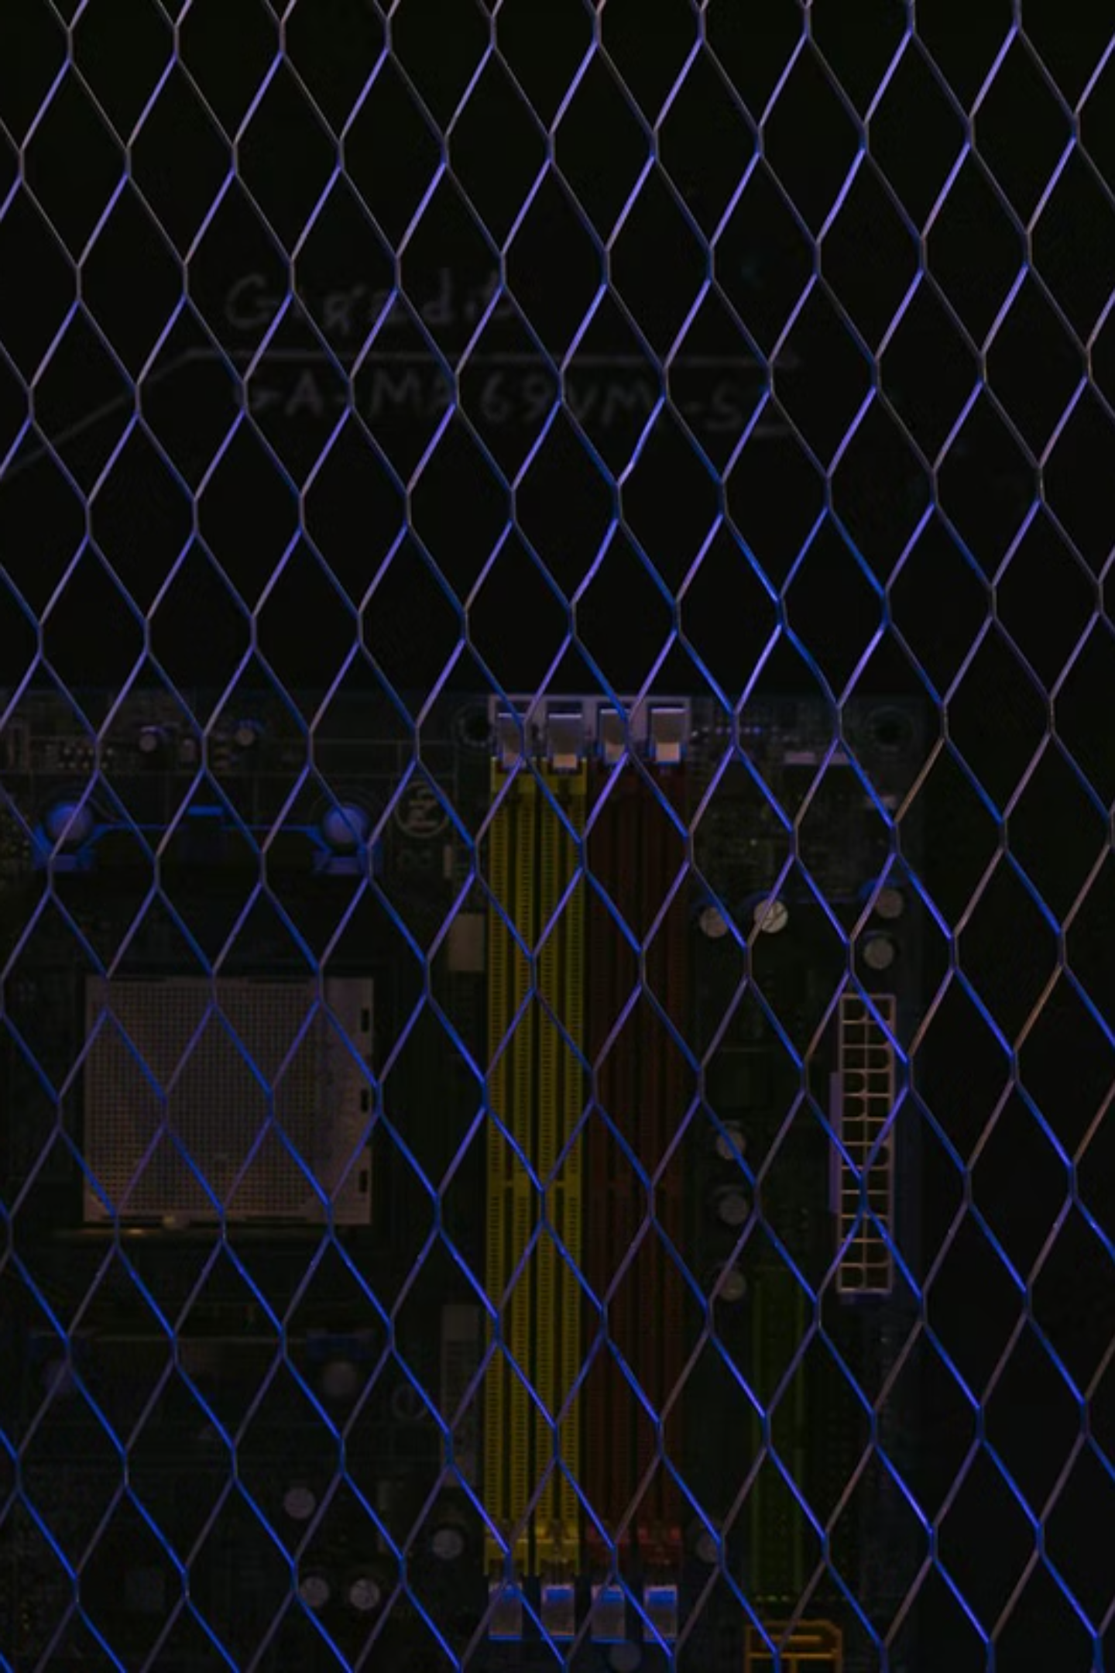
Project Objectives
1
Deep Learning Model Development
To design and implement a deep learning model capable of detecting synthetic media with high accuracy using diverse, real-world datasets.
2
Comparative Analysis
To conduct a comprehensive comparative study of various techniques for deepfake detection, including Convolutional Neural Networks (CNNs), Long Short-Term Memory networks (LSTMs), Transformers, and frequency-domain analysis.
3
Functional Prototype Construction
To build a functional prototype system demonstrating real-time image/video authentication capabilities.
4
Challenges and Future Potential
To analyze the inherent challenges, current limitations, and future potential of advanced deepfake detection systems.

Slide 7
Motivation & Scope
Motivation
Scope
The rapid growth of synthetic media technologies has introduced significant challenges in verifying digital authenticity. Fake media can be effectively misused for political manipulation, financial fraud, and the dissemination of social misinformation, eroding trust in digital content.
This project aims to develop a prototype detection system primarily focused on image-level classification of synthetic media. The scope is specifically limited to deep learning-based visual analysis, with an emphasis on identifying subtle artifacts and inconsistencies unique to AI-generated images.
This project is motivated by the urgent need to develop robust defense mechanisms against such threats, safeguarding information integrity and public perception.
Future extensions might include video and audio analysis, but the initial focus remains on static images.

Slide 8
Literature Survey: Detection Techniques
Our research involved a comprehensive review of existing deepfake detection methods, highlighting various approaches and their respective performance.
CNN-based Deepfake Detector
Convolutional Neural Network
FaceForensics++
~85–90%
Limited generalization across diverse deepfake types
XceptionNet
Depthwise Separable CNN
DeepFake Detection Challenge
~90–95%
High computational cost, slower inference
Vision Transformer (ViT)
Transformer-based Vision Model
CIFAKE / DFDC
~92–96%
Requires extremely large datasets for optimal performance
Frequency Domain Analysis
Fourier Transform Features
Celeb-DF
~80–88%
Sensitive to image compression artifacts
Multimodal Detection
Audio + Video + Image Fusion
DFDC
~95%+
Complex implementation, high resource demand

Slide 9

Proposed System Architecture
Our proposed system employs a robust deep learning pipeline specifically designed for accurate synthetic media detection. The workflow emphasizes efficiency and precision at each stage.
Input Image
Preprocessing
CNN Model
Classification

Slide 10

Dataset: CIFAKE
For training and evaluating our deep learning model, we utilize the CIFAKE dataset, sourced from Kaggle. This dataset is specifically curated for deepfake detection tasks, containing a balanced collection of both authentic and AI-generated images.
Dataset Distribution:
Classes:
Training Images: 100,000 images, providing extensive data for model learning.
Testing Images: 20,000 images, used for rigorous evaluation of model performance and generalization.
REAL images: Natural photographs, representing authentic visual content.
FAKE images: AI-generated synthetic media, produced by advanced models.
The large scale and balanced nature of the CIFAKE dataset are crucial for developing a robust and accurate deepfake detection system capable of identifying subtle artifacts in synthetic media.

Slide 11
DEMO

Slide 12


Slide 13


Slide 14


Slide 15
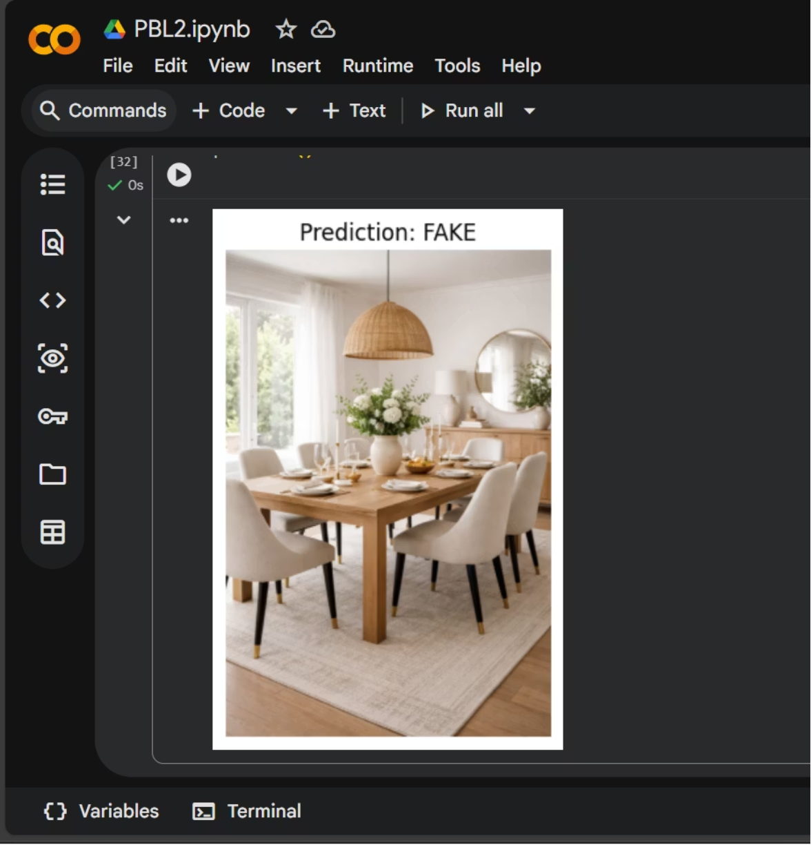

Predicting Objects

Slide 16
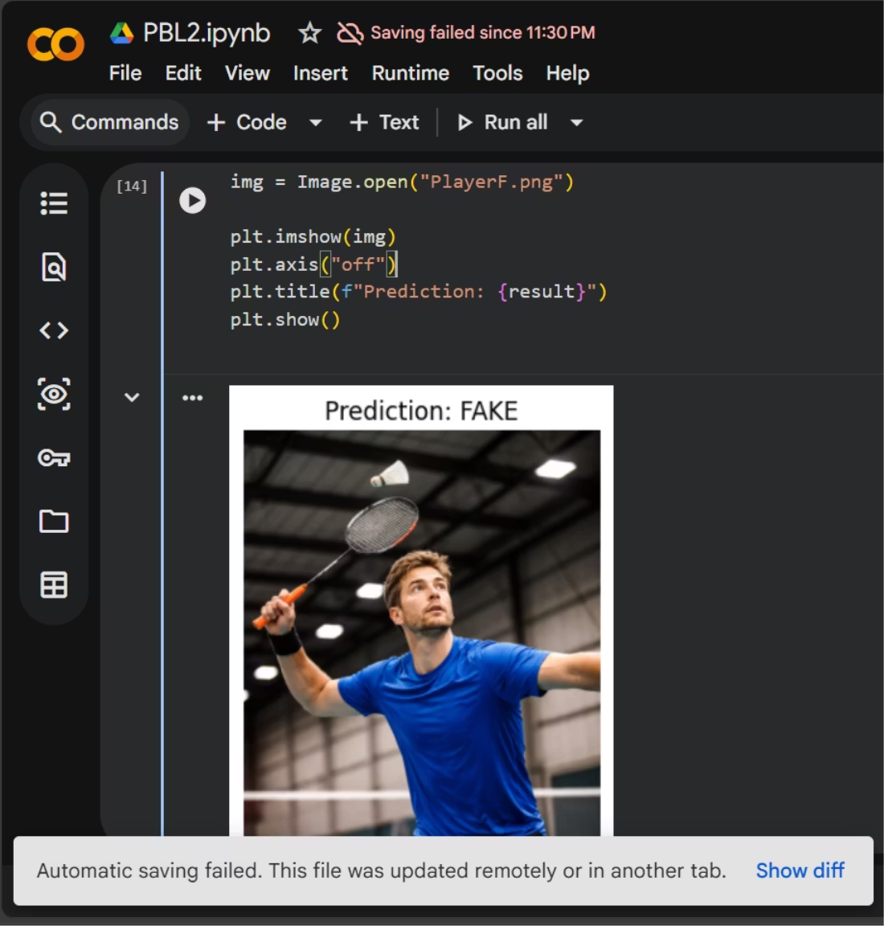

Predicting Objects

